Slide 1
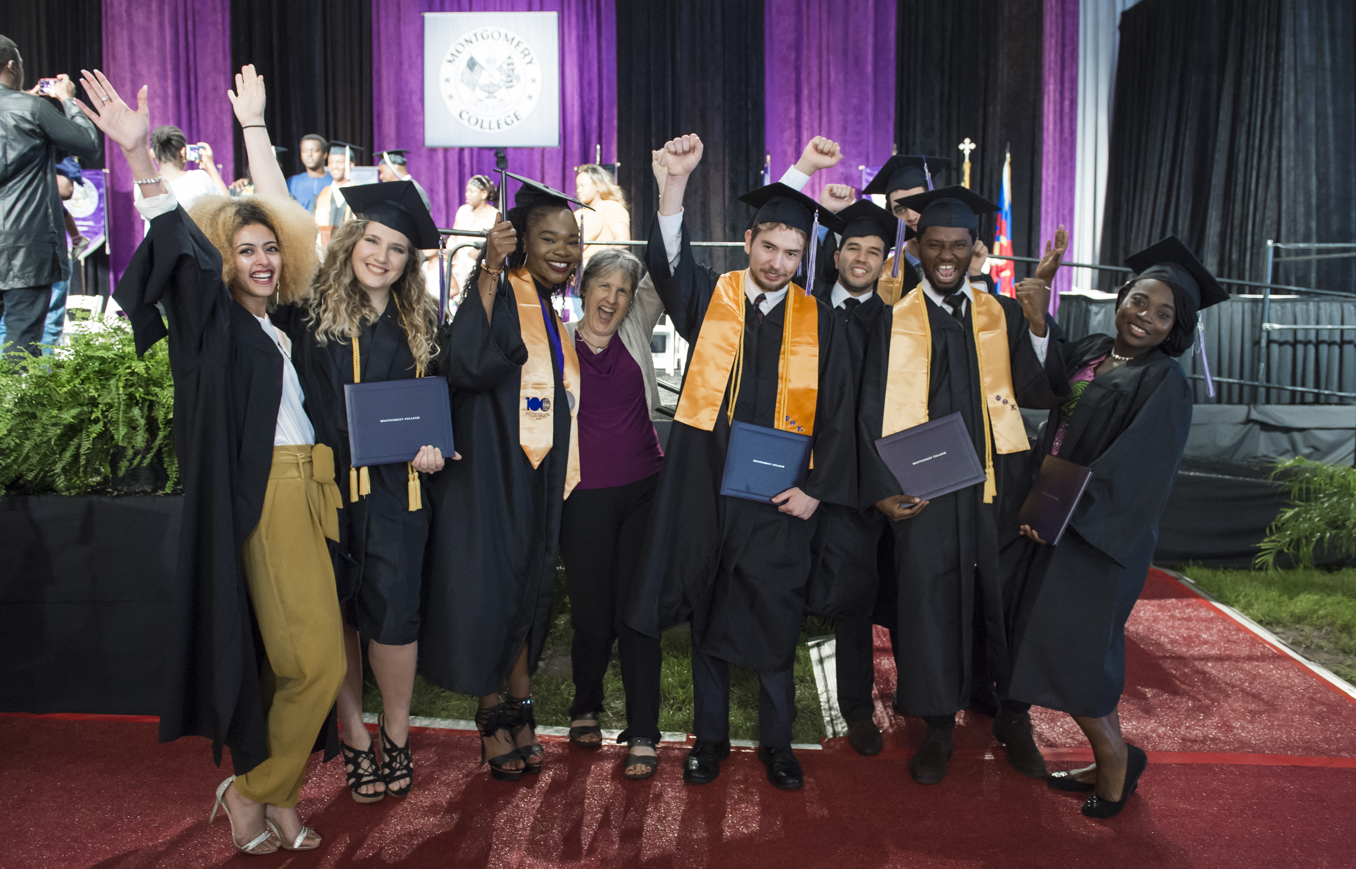
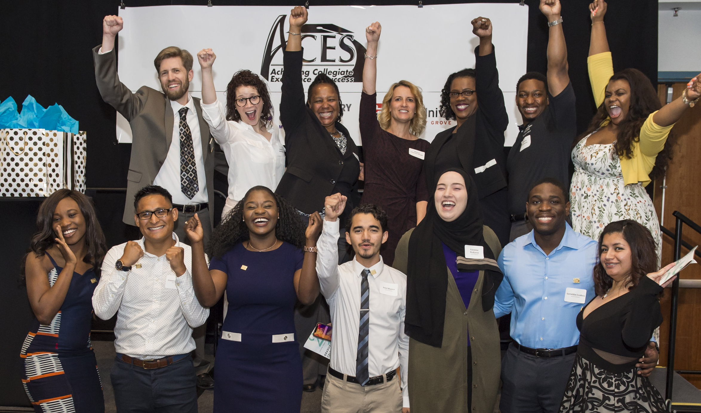

A COMMUNITY INVESTMENT IN STUDENT SUCCESS
An Opportunity for [INSERT NAME HERE]

Slide 2
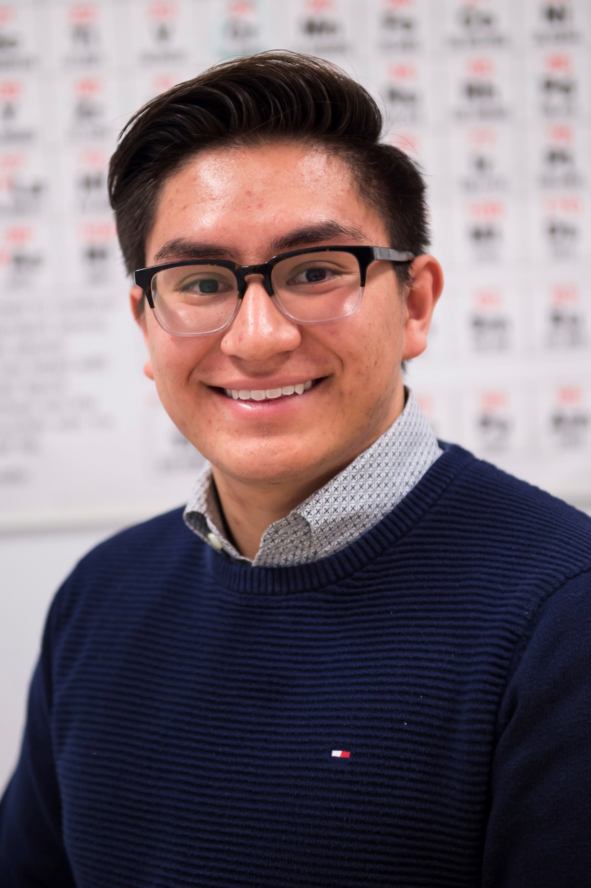
“Throughout my high school career, I knew college was the right decision. However, my parents knew very little about the college application process and education system. Achieving Colligate Excellence and Success (ACES) provided all the necessary support and guidance to help me continue my educational pathway. ACES has always shown relentless support at both an educational and emotional level.”
- Jorge Torres, ACES Student
Notes:
10:00am Carrie
Run through handouts and briefly describe the worksheets, especially the self guided worksheet.

Slide 3
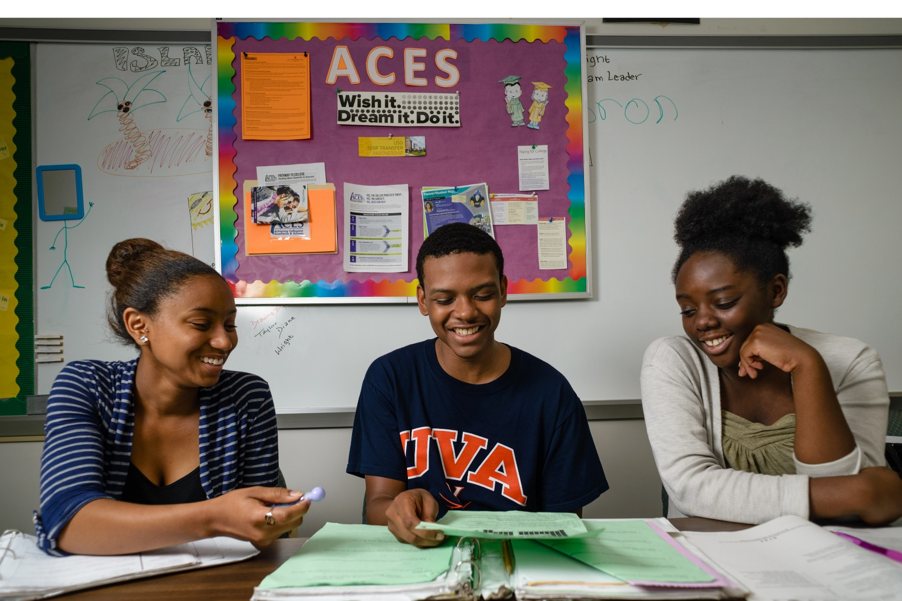
Higher Education Is Out of Reach for Many Students in Montgomery County
There remain significant barriers to entry into higher education and the workforce, especially for students from historically underrepresented backgrounds. Issues of access, affordability, and belonging put college out of reach for many students.
Of high school students nationally do not have access to a school counselor, many of whom are low income¹
Of students enrolled in higher education in the U.S. leave after their first year, citing lack of support²
Of people from low-income families have a bachelor’s degree by age 25, compared to 50% of high-income families³
21%
33%
10%
75%
Of new jobs in DC require education beyond a high school diploma⁴
Of high school students do not have access to a school counselor, many of whom are low income¹
Of students enrolled in higher education leave after their first year, citing lack of support²
Of people from low-income families have a bachelor’s degree by age 25, compared to 50% of high-income families³
Of new jobs in DC require education beyond a high school diploma⁴
Notes:
10:00am Carrie
Run through handouts and briefly describe the worksheets, especially the self guided worksheet.

Slide 4
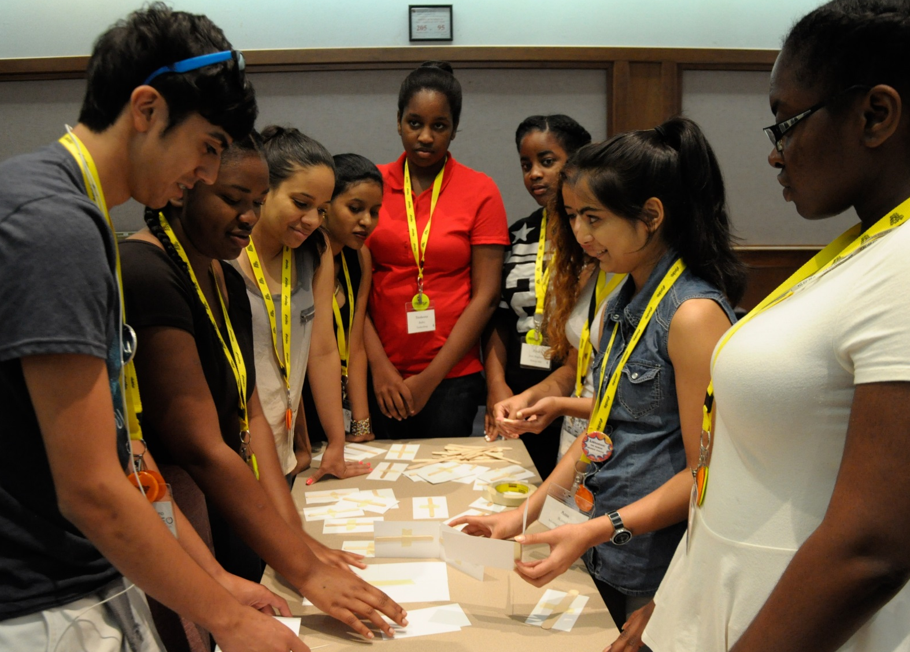

If Not Addressed, the Gap in College Attainment and Graduation Will Continue to Grow
Although Montgomery County Public Schools boasts one of the best graduation rates in the nation—with 90% of students earning a high school diploma—college achievement rates vary widely.
In higher income districts of the county, more than 8 in 10 adults 25 years and older have a postsecondary degree.
In lower income districts of the county, 5 in 10 adults 25 years and older have postsecondary degrees.⁵
This data suggests that gaps in graduation rates, college access, and degree attainment exist and ACES works to address these gaps.
Notes:
10:00am Carrie
Run through handouts and briefly describe the worksheets, especially the self guided worksheet.

Slide 5
ACES Provides a Realistic Pathway for
Students to Get to and Through College
Since its launch in 2013, ACES has been building equitable opportunities for students in Montgomery County to earn their bachelor’s degree and enter into a career.
A unique partnership between 14 high schools in Montgomery County Public Schools, Montgomery College, and the Universities at Shady Grove, ACES provides access to individualized coaching, scholarship opportunities, and career readiness.
The results are a sharp increase in;
Equipping students to join the region’s workforce and contribute back to the local economy.
College
Readiness
College Applications
Graduation
Rates
Notes:
10:00am Carrie
Run through handouts and briefly describe the worksheets, especially the self guided worksheet.

Slide 6
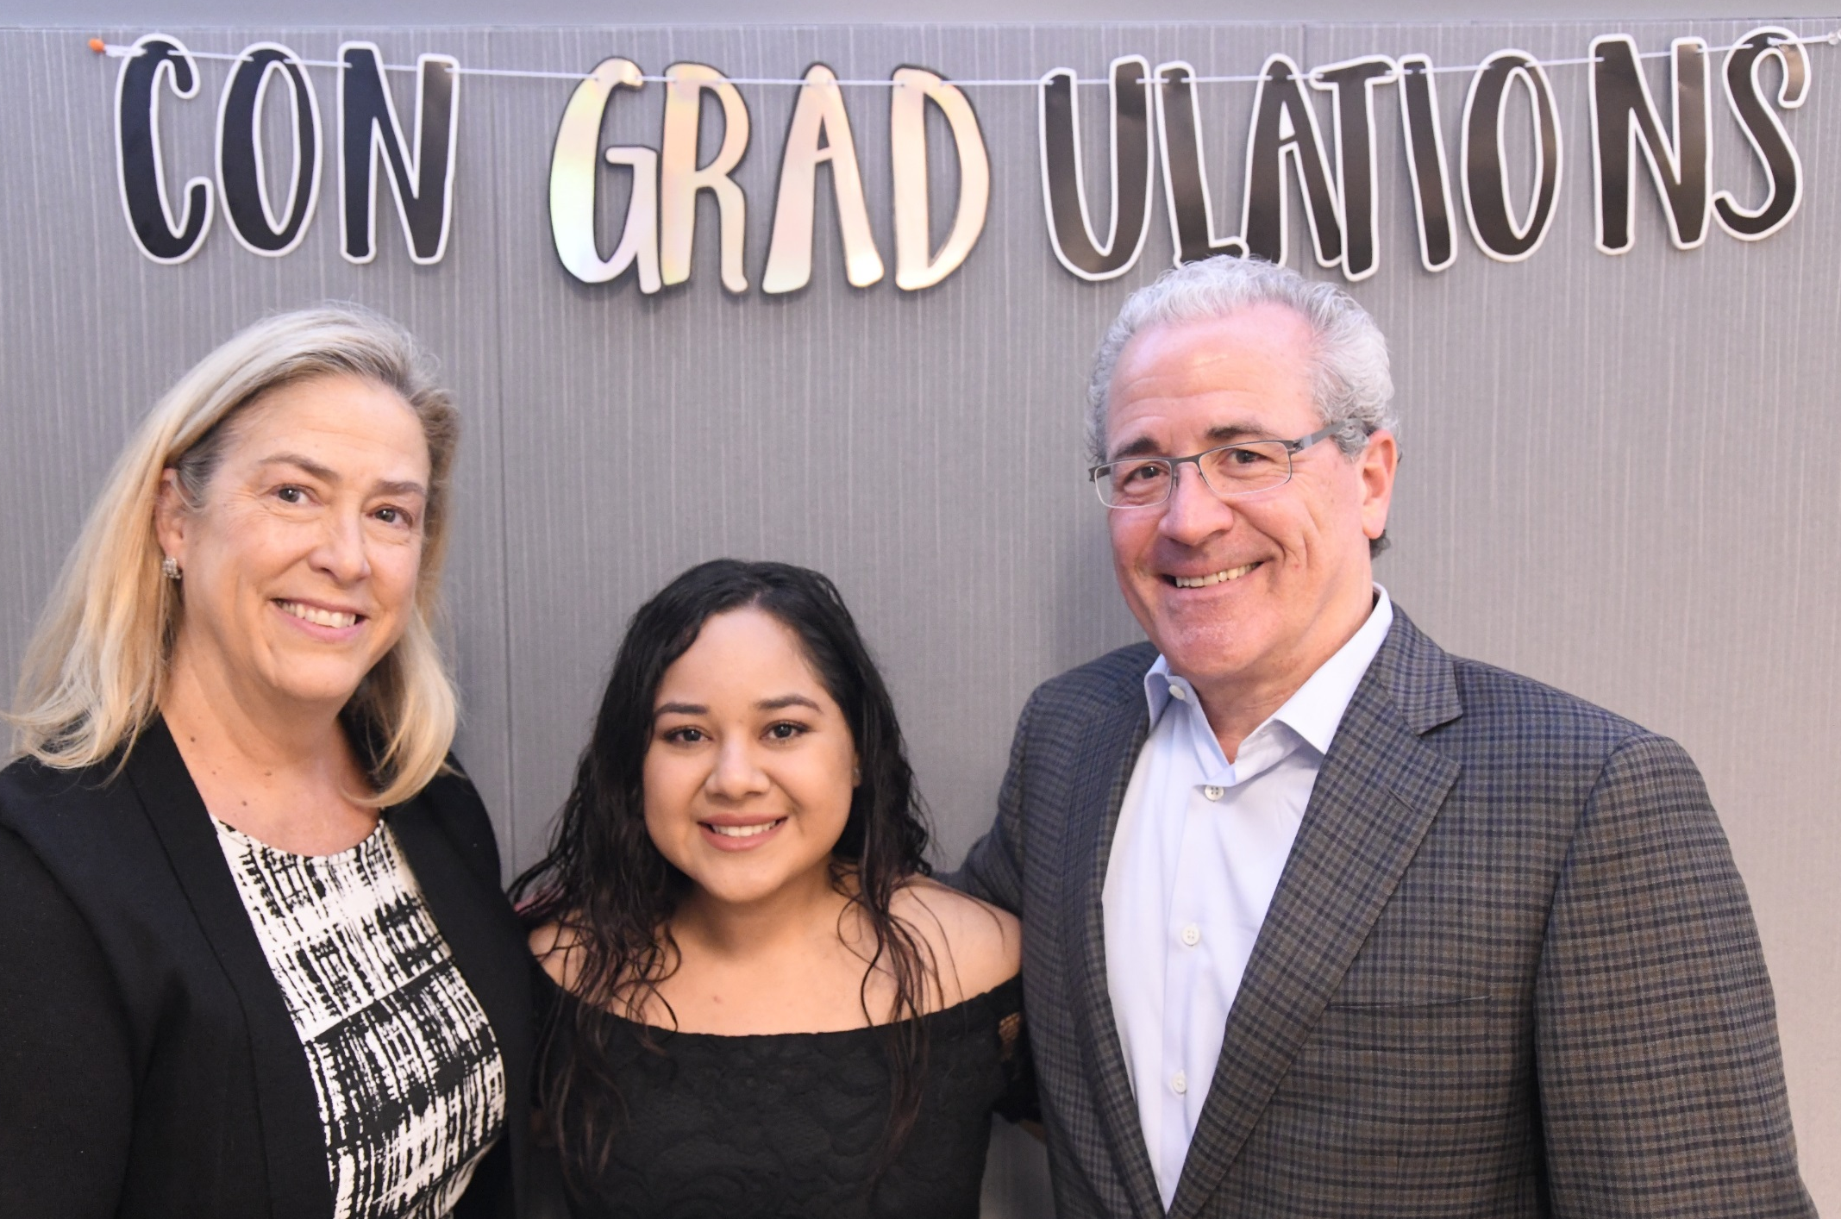
A Catalyst to Personal, Academic, and Professional Success
Sara didn’t consider attending college until ACES showed her it was possible.
Through individualized coaching and college application guidance, she received a full ride scholarship, and is the first in her family to attend college. Sara graduated from the University of Maryland’s Robert H. Smith School of Business in the fall and start working fulltime at the global accounting firm, Grant Thornton.
“ACES helped me develop a personality that I never knew I had. It has made me the woman I am today and I am so thankful for all of the opportunities to grow.” – Sara Ruiz, ACES Graduate
Notes:
10:00am Carrie
Run through handouts and briefly describe the worksheets, especially the self guided worksheet.

Slide 7
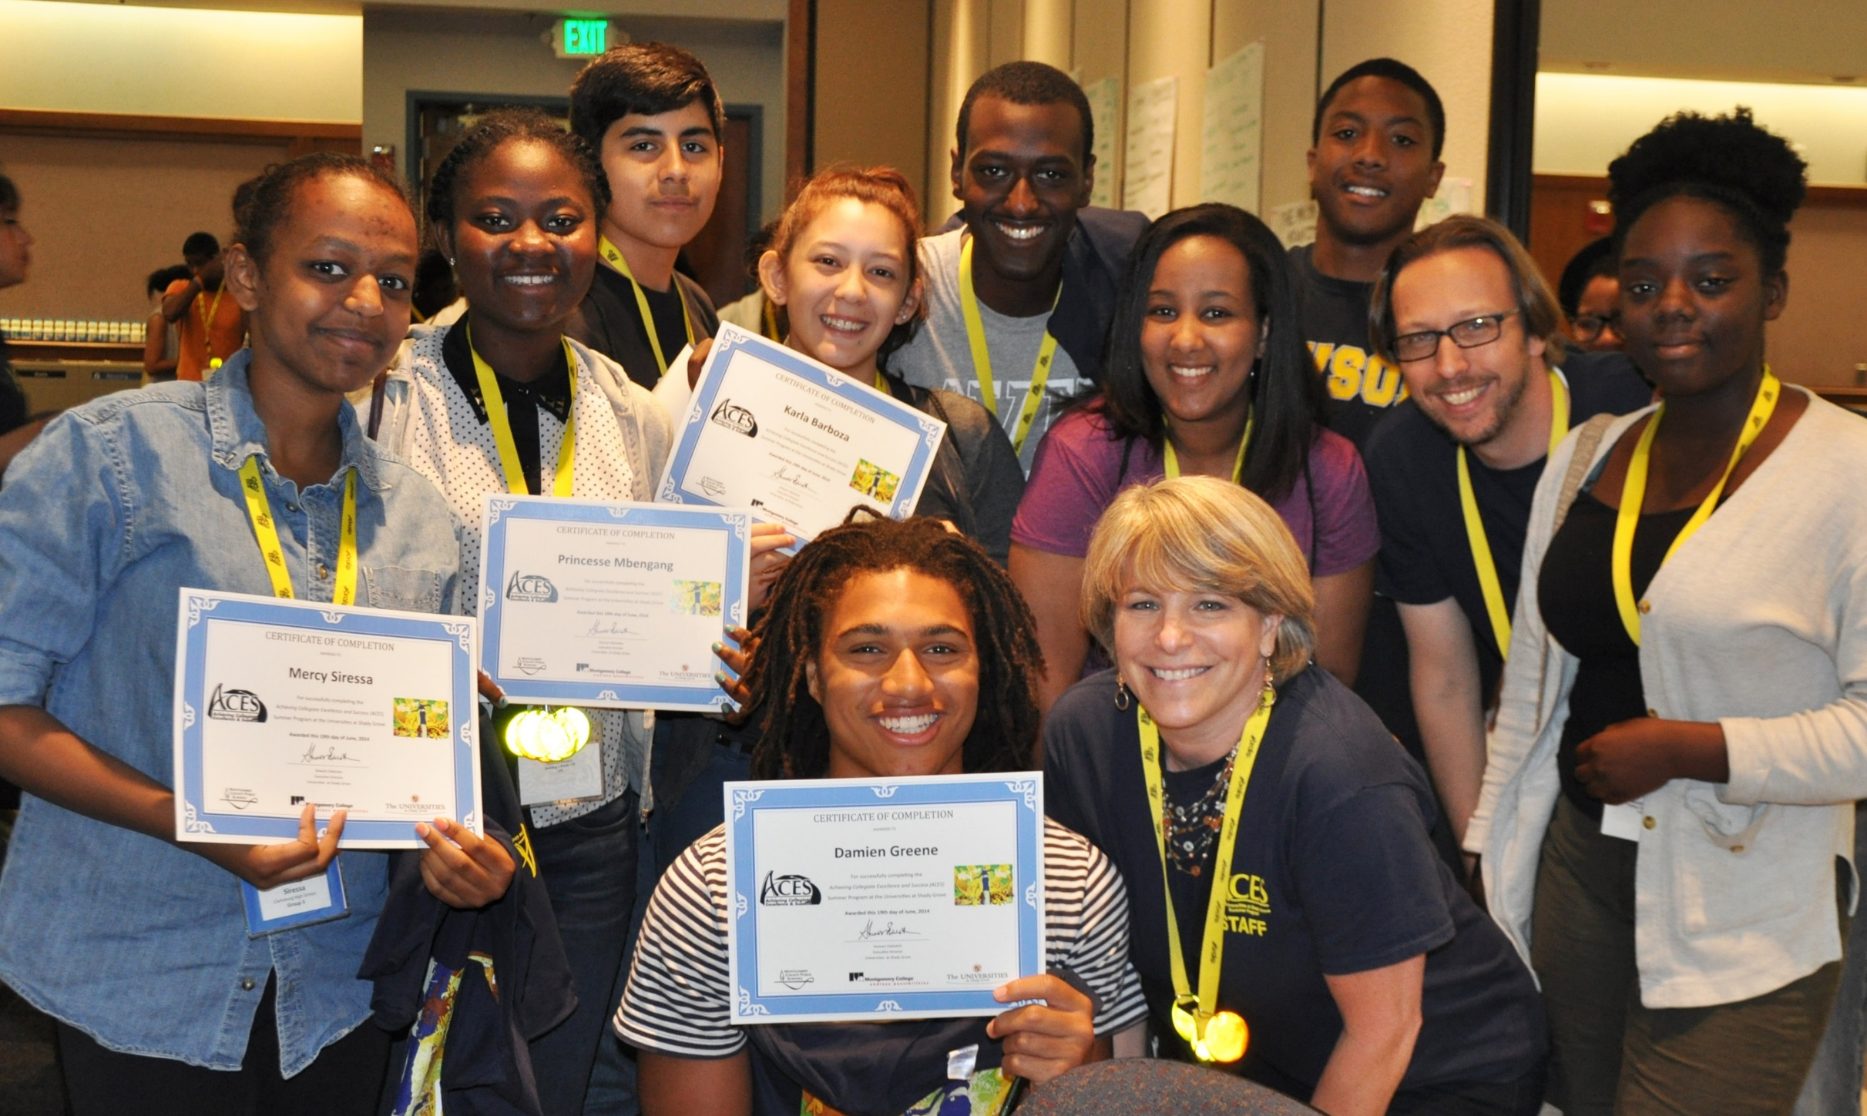
Our Coaches Work with Students, Every Step of the Way
Our coaches work with students every step of the way, beginning in the 11th grade, continuing to community college, and through the completion of a bachelor’s degree.
This pathway provides seamless transitions from each institution, ultimately creating a better equipped and more highly skilled workforce.
Notes:
10:00am Carrie
Run through handouts and briefly describe the worksheets, especially the self guided worksheet.

Slide 8
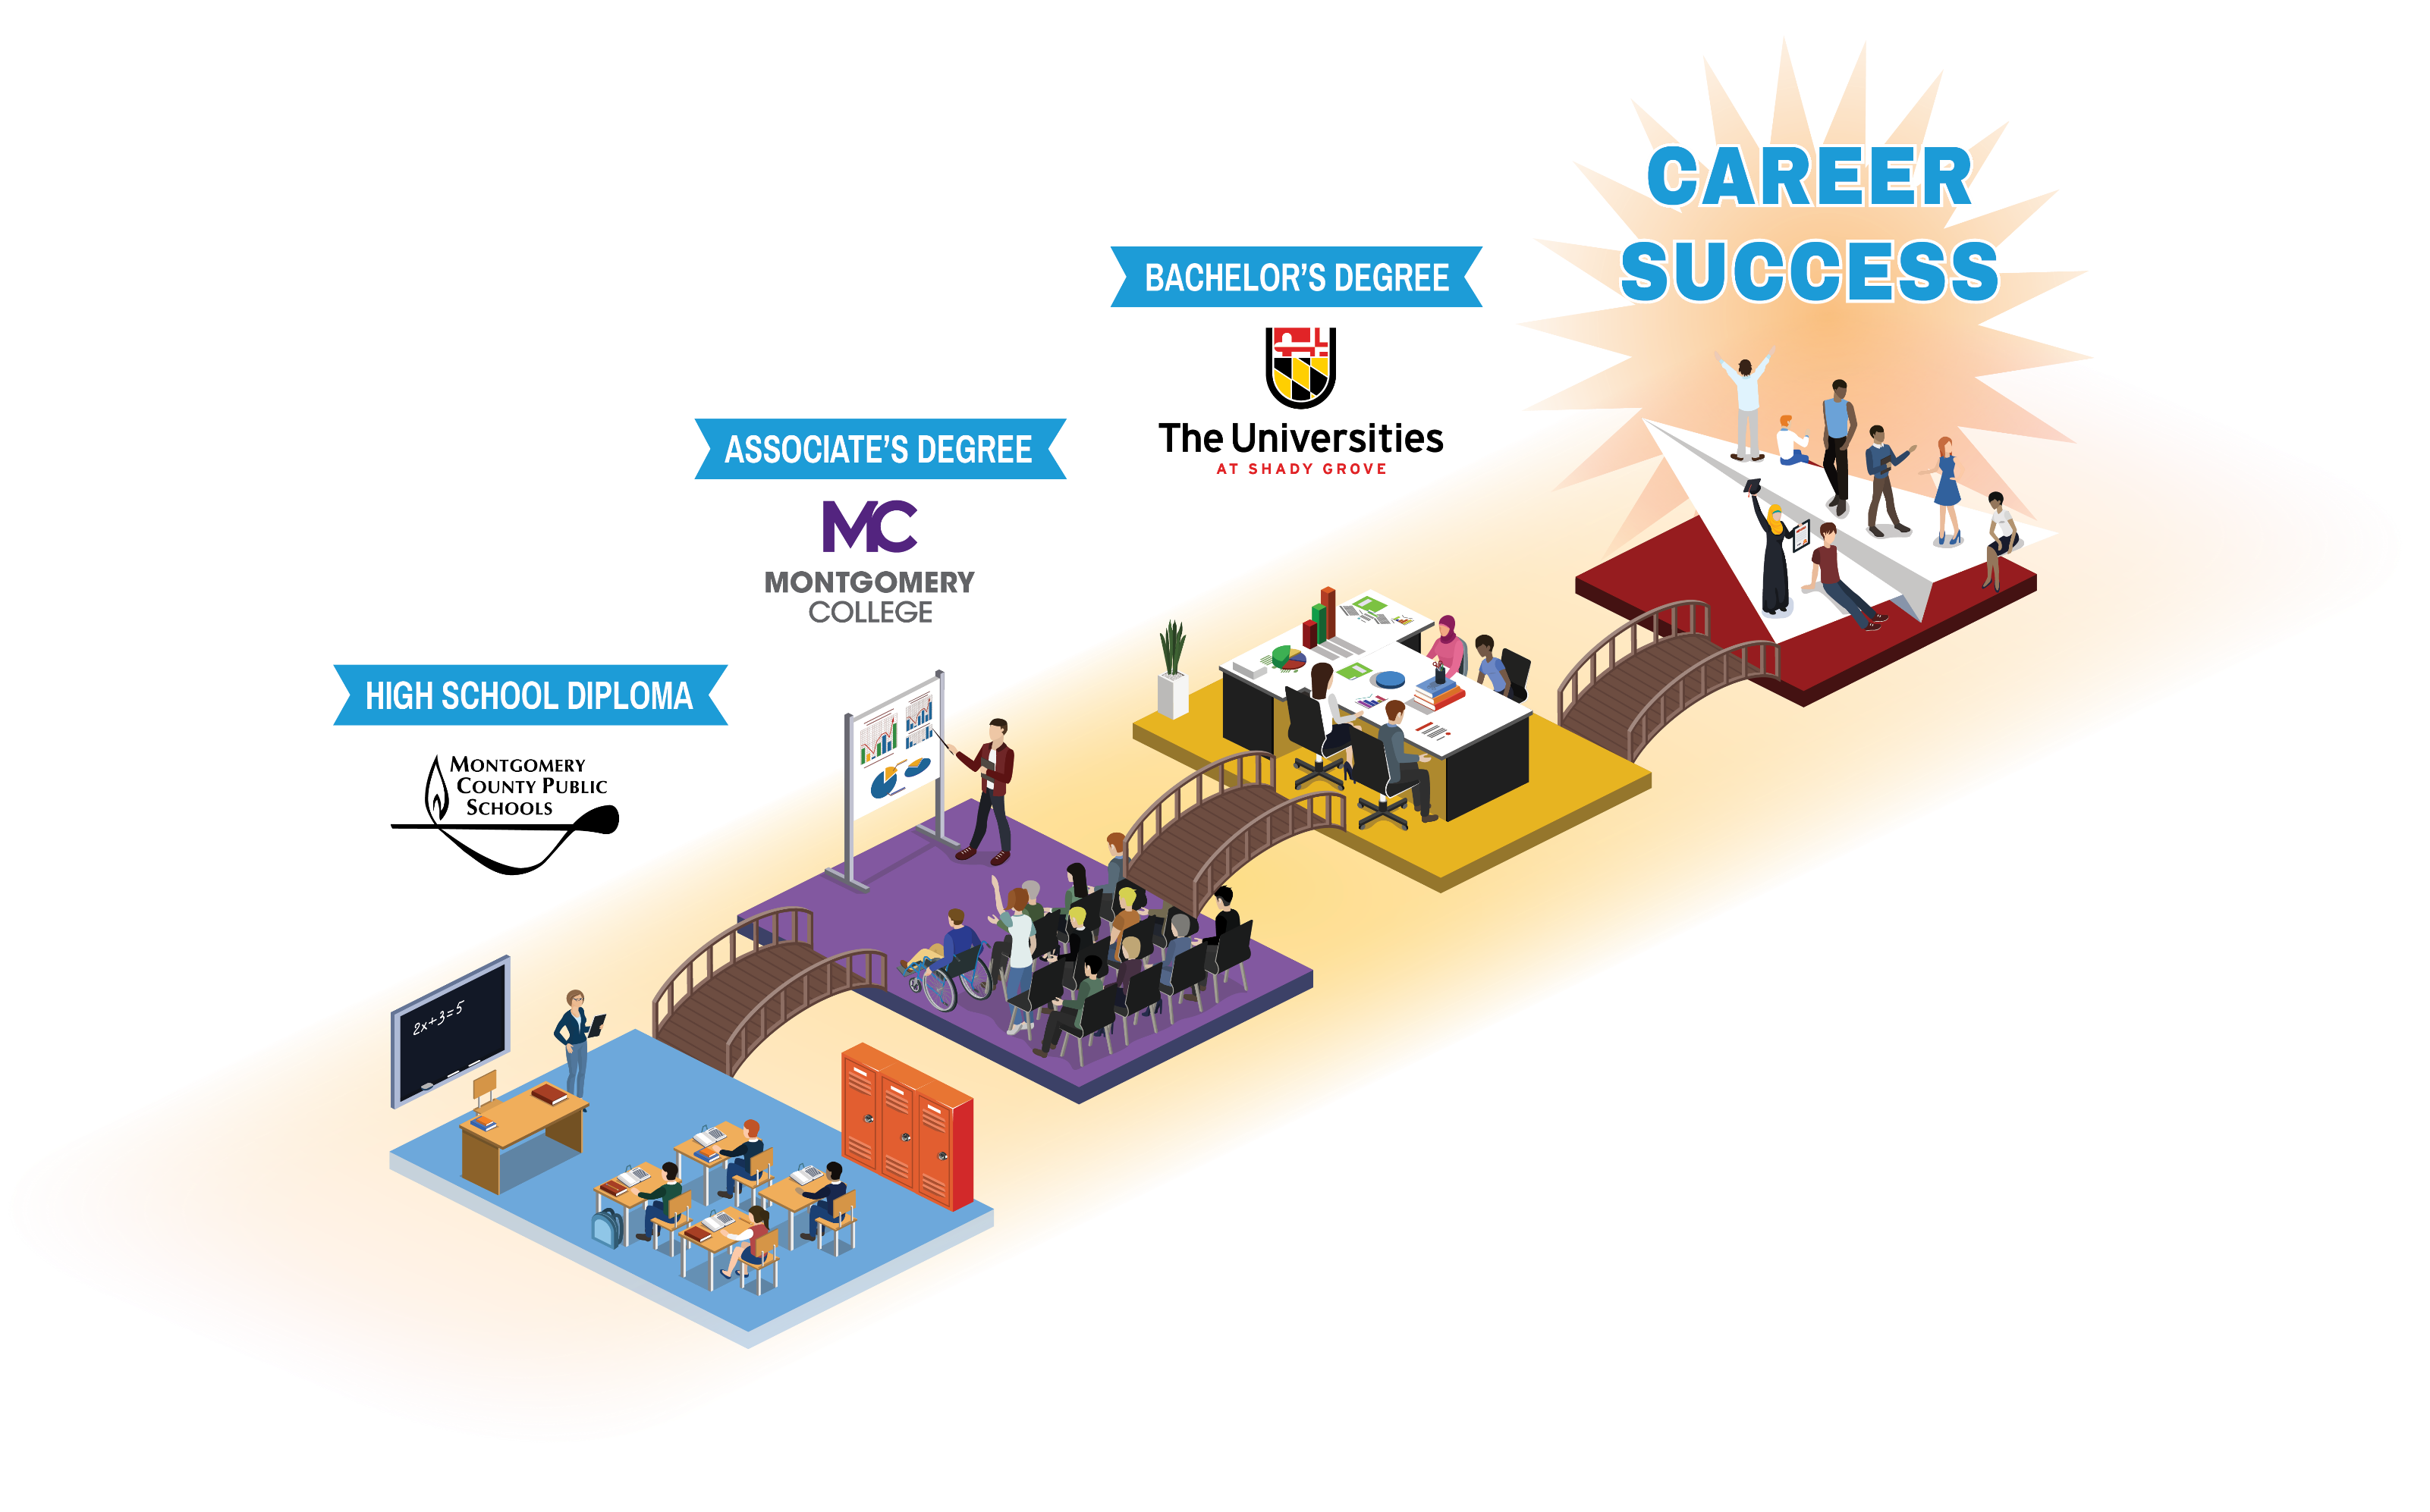
A Supportive Pathway to Thrive in College and Enter into a Career
Notes:
10:00am Carrie
Run through handouts and briefly describe the worksheets, especially the self guided worksheet.

Slide 9
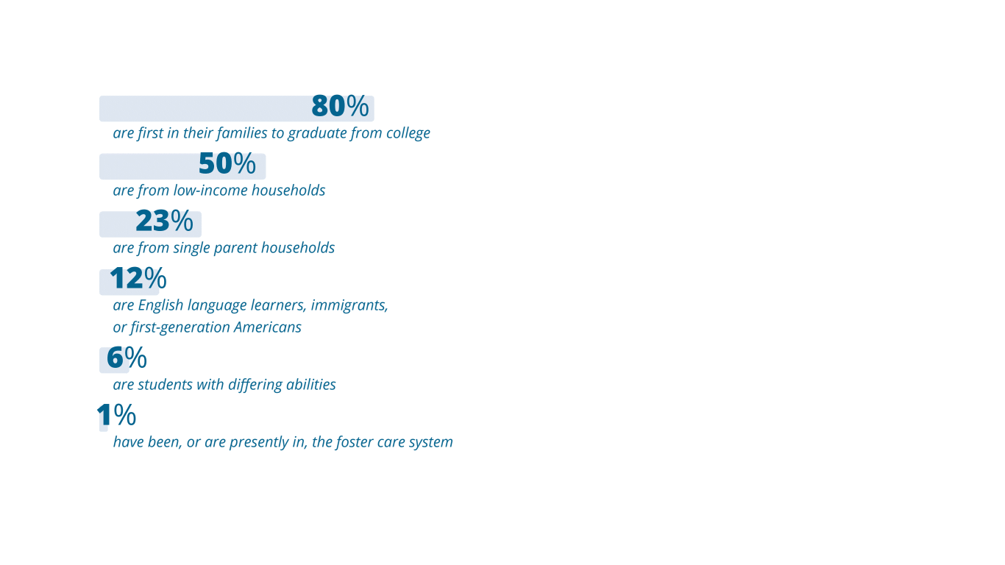
ACES Sees Promise in Our Students and Believes in Their Potential
ACES students are often the first in their family to pursue college.
They may be first-generation Americans, immigrants, from a low-income family, or have differing abilities that have limited their opportunity to pursue a bachelor’s degree.
Our students represent a wide range of backgrounds and experiences, including;
Notes:
10:00am Carrie
Run through handouts and briefly describe the worksheets, especially the self guided worksheet.

Slide 10



Our Impact Is Felt Throughout the Entire Community
2,500+
Students supported with critical education and coaching services each year
99%
Nearly all ACES students receive their high school diploma and enter into higher education
2X
ACES students are twice as likely to receive financial aid than their peers
ACES impact is felt far beyond the number of students served. ACES serves as a lifeline for parents, a point of inspiration for siblings, a challenge for peers, and a
powerful tool for fostering future leaders.
Notes:
10:00am Carrie
Run through handouts and briefly describe the worksheets, especially the self guided worksheet.

Slide 11
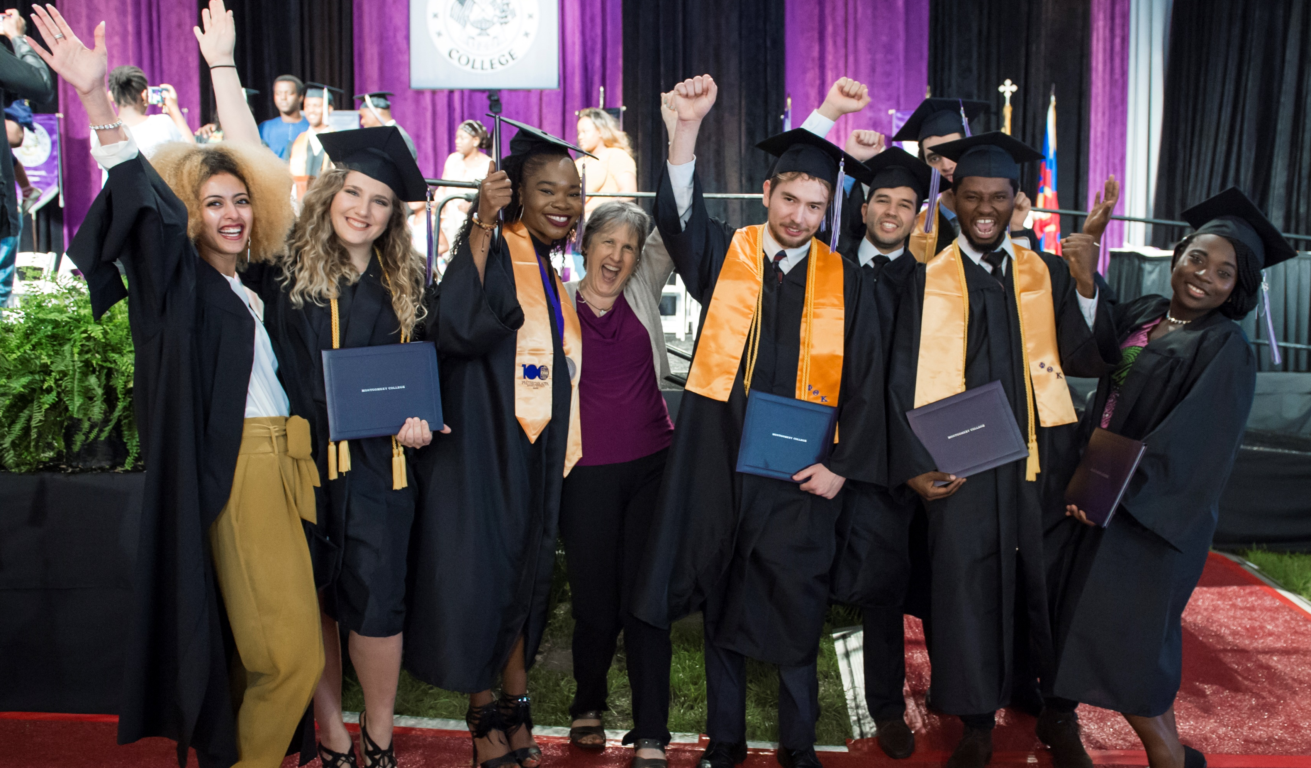
A ROLE FOR
[INSERT FUNDER NAME HERE]

Slide 12
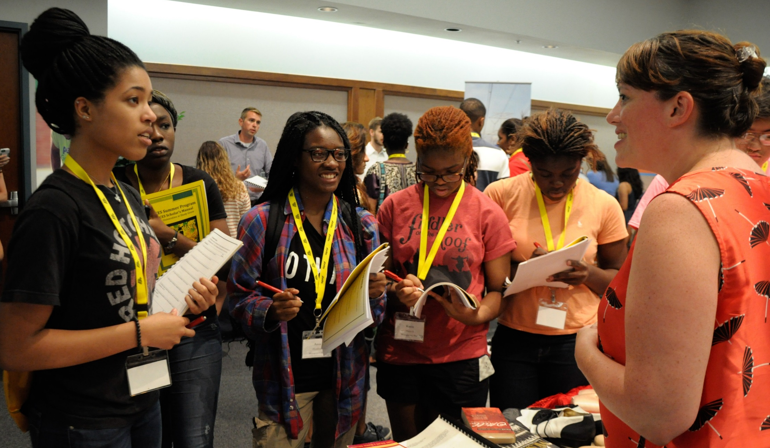
Invest in the Promise of Our Students and Our Region
Together, [INSERT FUNDER NAME HERE] and ACES can support an even greater number of Montgomery County students and their families in their pursuit of higher education.
An investment in ACES is an investment in all of Montgomery County’s public education institutions. Your investment—no matter the size—benefits the entire county, now and into the future.
“I like to think of ACES as a family, I have made great friends and mentors through the ACES program and I am so thankful.” - Jathselle Pierre-Louis, ACES Graduate
Notes:
10:00am Carrie
Run through handouts and briefly describe the worksheets, especially the self guided worksheet.

Slide 13

Partnership Idea #1: Fuel the Future of Our Region’s Workforce
A critical aspect of ACES is preparing students to excel in the workforce by providing hands-on opportunities to learn and grow.
Consider partnering with ACES to provide:
Internships or full-time jobs
Networking opportunities
Career readiness curriculum
Immersive workforce development experiences
Funding to offset internships or career readiness costs
Notes:
10:00am Carrie
Run through handouts and briefly describe the worksheets, especially the self guided worksheet.

Slide 14
Partnership Idea #2: Innovative Scholarships for Students
For ACES students, funding a scholarship is not just about covering the basic costs of education, it is providing a realistic and achievable pathway for students to envision themselves obtain a bachelor’s degree.
* Total cost includes tuition and fees, textbooks, developmental courses assuming 60 credits at MC and junior and senior year at USG.
Student with Full Federal PELL Grant
MC cost = $5,000, USG cost = $17,400
Total cost to obtain bachelor’s degree = $22,400
Student with Partial Federal PELL Grant
MC cost = $9,500, USG cost = $23,400
Total cost to obtain bachelor’s degree = $32,900
One Dream Act Student
MC cost = $15,000, USG cost = $29,400
Total cost to obtain bachelor’s degree = $44,400
Notes:
10:00am Carrie
Run through handouts and briefly describe the worksheets, especially the self guided worksheet.

Slide 15
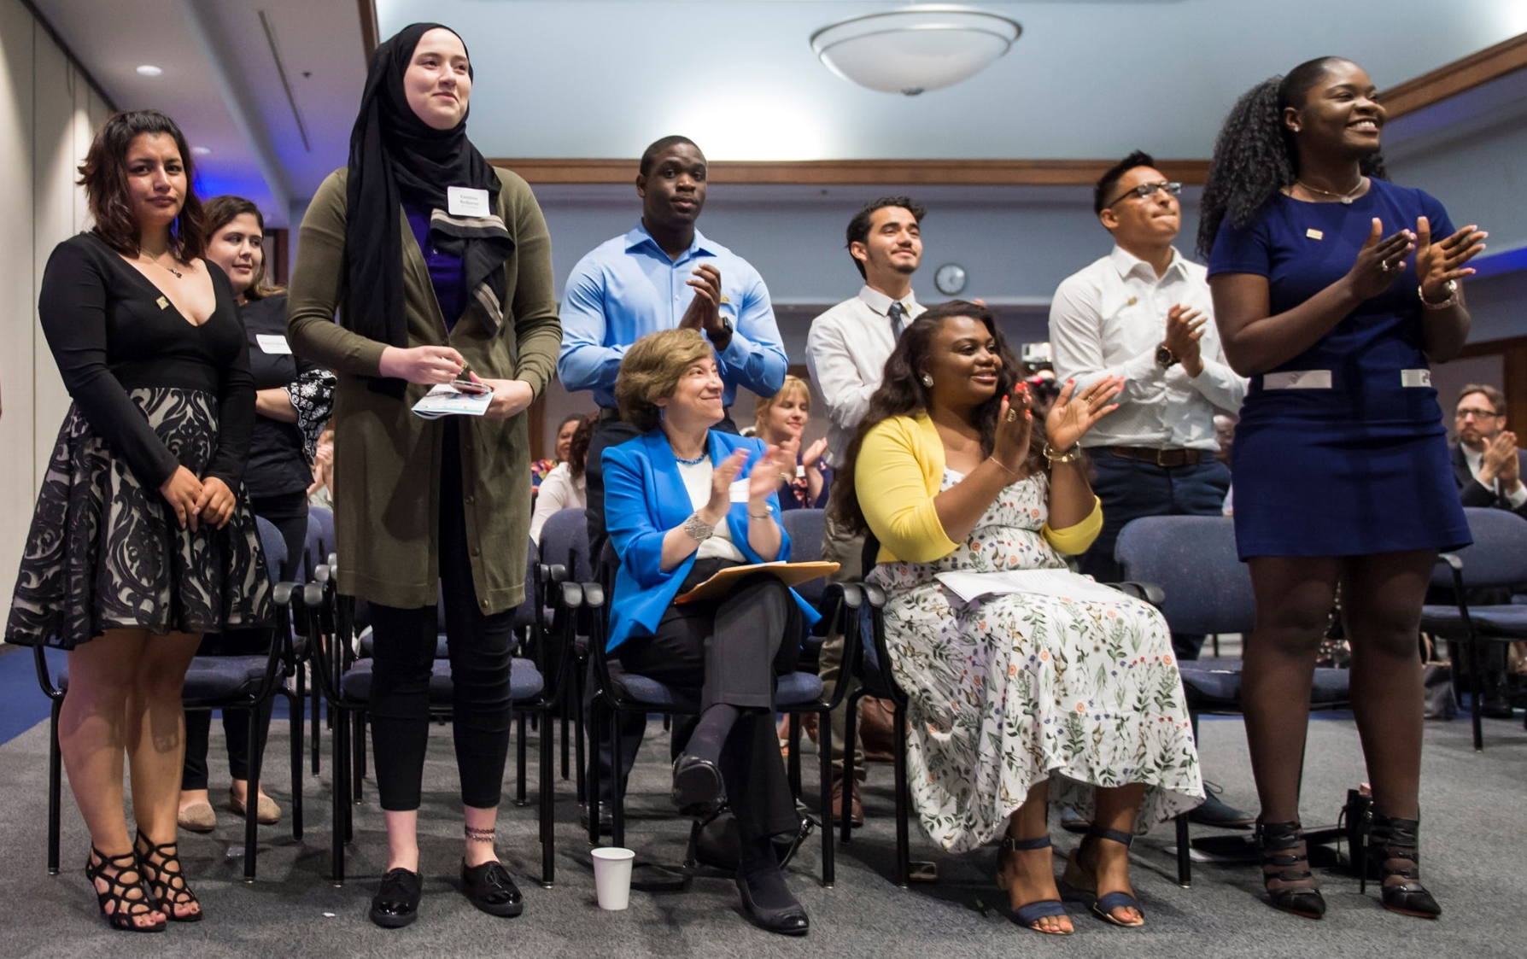
Partnership Idea #3: Invest in Our Transformational Model
As a first-of-its-kind collective impact model, ACES works with three public education institutions to transform the higher education experience for students who need it the most.
Consider investing in our partnership through:
Offsetting the cost of coach and staff member salaries
Funding research and impact collection
Providing high school to college and college to career transition supports
Notes:
10:00am Carrie
Run through handouts and briefly describe the worksheets, especially the self guided worksheet.

Slide 16
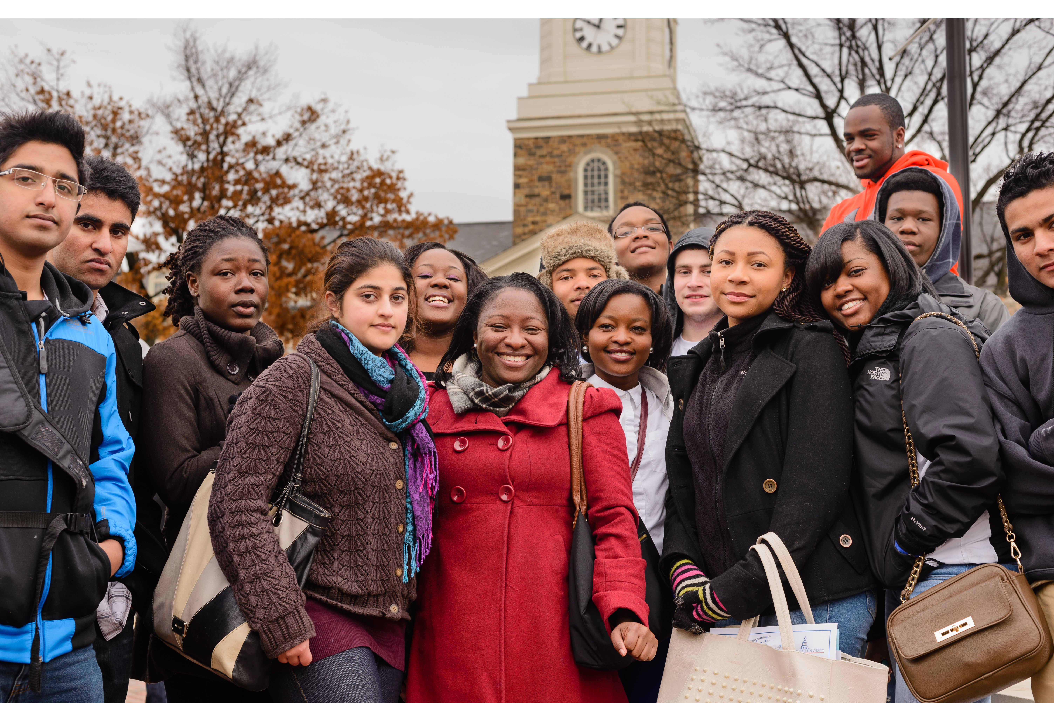
THANK YOU

Slide 17



Your Partners for Success
Richee L. Smith Andrews
Chief Advancement Officer
Rsmith25@umd.edu
301-738-6113
The Universities at Shady Grove
9636 Gudelsky Drive
Rockville, MD 20850
shadygrove.umd.edu
David M. Sears
Sr. Vice President for Advancement and Community Engagement
David.sears@montgomerycollege.edu
240-567-7492
Montgomery College
9221 Corporate Boulevard
Rockville, MD 20850
montgomerycollege.edu
Elaine Chang-Baxter
Director of Partnerships
Carver Educational Services Center Elaine_L_Chang-Baxter@mcpsmd.org
301-217-5370
Montgomery County Public Schools
850 Hungerford Drive
Rockville, MD 20850
montgomeryschoolsmd.org
Notes:
10:00am Carrie
Run through handouts and briefly describe the worksheets, especially the self guided worksheet.

Slide 18

1. "Equality Isn’t Equity: Every Student Needs A Great School Counselor." The Education Trust. January 2018. Retrieved from: https://edtrust.org/resource/equality-isnt-equity-every-student-needs-great-school-counselor/
2. Ron Haskins, Harry Holzer, Robert Lerman. “Promoting Economic Mobility by Increasing Postsecondary Education.” Pew Charitable Trusts. May 2009. Economic Mobility Project, pp. 43-44.
3. Martha J. Bailey, Susan M. Dynarski. “Inequality in Postsecondary Attainment.” Russell Sage Foundation.
2011. Whither Opportunity: Rising Inequality, Schools, and Children's Life Chances, pp. 117-132.
4. Heather Boushey, Shawn Fremstad, Rachel Gragg, and Margy Waller. "Understanding Low-wage Work in the United States.“ Center for Economic Policy and Research. 2007.
5. “Educational Attainment in Montgomery County, Maryland”. Statistical Atlas, U.S. Census Bureau. April 2015.

